Slide 1
Topics, Research Agenda, Cooperation Principles
Maria Semenova (msemenova@hse.ru)
Deputy Director and Senior Research Fellow, CInSt HSE
Associate Professor, School of Finance, HSE

Slide 2
Smth about me:
Main areas of interest and expertise:
(Mostly) empirical banking
Household finance (~bank-related)
Recent publications:
  Semenova M. Do Smart Depositors Avoid Inefficient Bank Runs? An Experimental Study // Emerging Markets Finance and Trade. 2023. Vol. 59. No. 8. P. 2710-2726.
  Semenova M., Popova P. Time to Extend Credit? Bank Credit Lines during the COVID-19 Pandemic in Russia // Russian Journal of Money and Finance. 2023. Vol. 82. No. 2. P. 106-119.
  Iakimenko I., Semenova M., Zimin E. The more the better? Information sharing and credit risk // Journal of International Financial Markets, Institutions and Money. 2022. Vol. 80. Article 101651.
  Guillemin F., Semenova M. Transparency and market discipline: evidence from the Russian interbank market // Annals of Finance. 2020. Vol. 16. No. 2. P. 219-251.
  Semenova M., Shapkin A. Currency Shifts as a Market Discipline Device: The Case of the Russian Market for Personal Deposits // Emerging Markets Finance and Trade. 2019. Vol. 55. No. 10. P. 2149-2163.
  Schoors K., Semenova M., Zubanov A. Depositor discipline during crisis: Flight to familiarity or trust in local authorities? // Journal of Financial Stability. 2019. Vol. 43. P. 25-39.
  Semenova M., Andrievskaya I. K. Does biological endowment matter for demand for financial services? Evidence from 2D:4D ratio in the Russian household survey // Personality and Individual Differences. 2017. Vol. 104. P. 155-165.

Slide 3
Important notes
YES!
  You can come with any other research idea, but be sure that
    It is related to banking/household finance
    The data is available
NO!
  Don’t come saying “I just need to have this term/diploma paper done somehow. So give me any topic and I’ll take it”
  More about working with me

Slide 4
COVID-19 and banking
“Perfect example of external, non-economic shock”
Influencing households (physical limitations, unemployment, liquidity shocks, uncertainty, …) – depositors and borrowers
Influencing firms (disruption of production chains, credit rationing uncertainty) - borrowers
Therefore influencing banks (increased risks VS financial innovations)
Regulators do react

Slide 5
COVID-19 and banking - questions
  Different banking markets under pandemic pressure:
    Who suffers worse where, how and why
    Who copes better where, how and why
  Regulatory interventions under pandemic pressure
    Who did what, where and why
    Restrictions VS Support measures
    Bank-related VS Bank-unrelated measures
  A combination of the two
  Any good news? Financial innovations, ecosystems, banks and public procurement (e.g. medicine)

Slide 6
Market Discipline
  Definition: creditors’ (usually depositors’) sensitivity to bank risks: interest rates, funds growth rates, funds structure…
  Questions:
  What undermines MD?
    Crisis (including external shocks)
    Explicit guaranties (deposit insurance)
    Implicit guaranties (ownership structure, ties with government, regions, municipalities…, any signs of those - bank titles, bank brands…)
    Information environment (transparency, financial literacy…)
  Where to find MD?
    Credit market, interbank market…
    New mechanisms
  Does MD influence risk appetite?

Slide 7
Deposit insurance
Designed to resolve bank bankruptcies efficiently and increase trust to banks
Aims at banking system stability, but produces moral hazard
Should be priced fairly according to bank risks, but it does not work when systemic risk is realized or a simultaneous failure occurs (the recent US case is a good example)
Questions:
How to design the DIS optimally?
Are there other mechanisms for the current “new normal”? Guaranteeing instead of insuring?

Slide 8
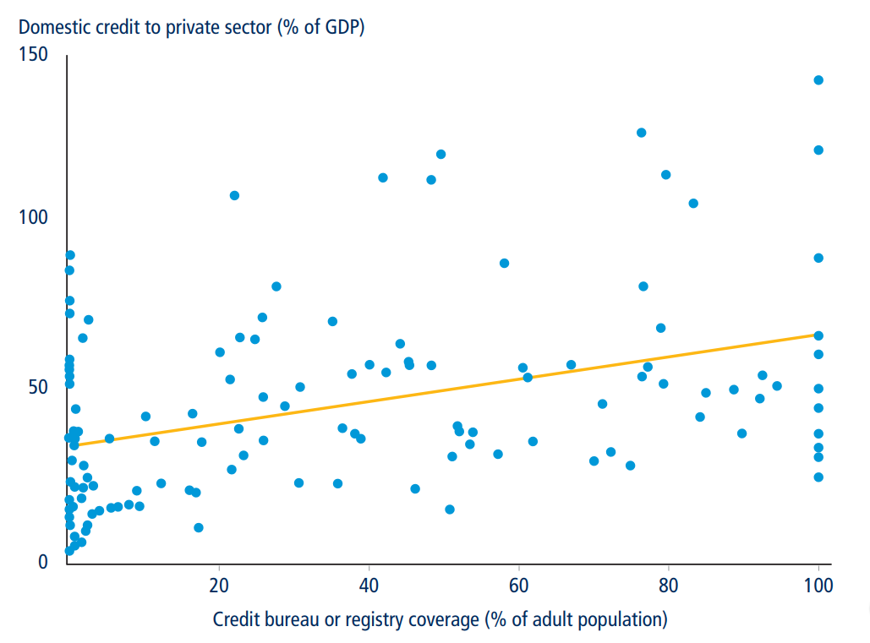
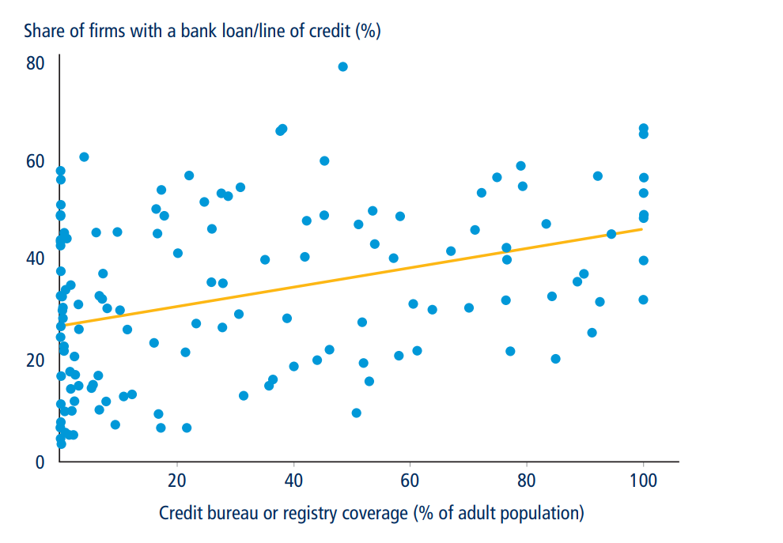
Information Intermediation in Credit Markets
Credit bureaus and credit registries
Doing Business 2017:
Questions:
  Influence of institutional factors?
    Creditor rights
    Collateral registries

Slide 9
Non-bank banking
  Microfinance VS banks
    Regulatory differences
    Competition VS efficient market sharing
  Microfinance: efficient business models
    Social aspect
    Microfinance as a source of economic growth (e.g. via SMEs)
  Other sources of funds, coming outside the financial institutions
    Non-economic sources of credit discipline

Slide 10
Household finance
  Using the banks for savings vs borrowings vs payments
    Or a combination?
    What influences the choice?
    Credit: rationing vs borrower choice
    Non-banking markets
  The whole range of new payment services and cashless payment instruments
    What influences the choice?
    What makes to hold a bundle?
  Non-financial factors
    Financial literacy
    Trust to banks
    …

Slide 11
Other topics
Bank regulation: how regulatory differences influence banking markets’ outcomes
Banking in Russian regions: access to finance, involvement into banking markets, bank regional development…
Banks and Financial innovations, FinTech, etc… (if you know how to measure it)
ESG and banking: does it pay-off to be green? (if you have the data on being green)
Corporate governance in banks: how different dimensions influence bank risks and outcomes (if you have the data on CG)
Banking and the real economy: how banks save the day
Islamic banking

Slide 12
Thank you!

